Slide 1
Dumbways Bootcamp Devops
Week 4
Gilbran Fairuz Maulana

Slide 2
Task Week 4
01
SETUP MONITORING SERVER
02
CONNECT MULTIPLE SERVER TO PROMETHEUS
03
DEPLOY PHP APPLICATION IN CPANEL
04
SETUP SERVER WITH ANSIBLE
Create a new server for monitoring
Reverse proxy monitoring for https://monitoring.gilbran.instructype.com
Monitoring can display cpu and memory process
Monitoring can display storage and network process
Deploy PHP Application
Choose one (phpBB, Vanilla Forums, CodoForum, FluxBB, Simple Machine Forums, Joomla)
Create Repository for ansible
Create 6 new Server
Setup 6 server using ansible ( 1 Nginx, 1 Database, 4 Docker (Jenkins, Monitoring, Frontend Backend))

Slide 3
SETUP MONITORING SERVER
01

Slide 4
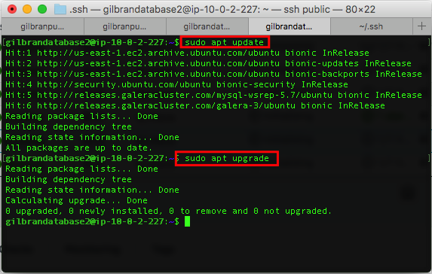
SETUP MONITORING SERVER
Install Node Exporter.
Node Exporter diinstall diseluruh server yang bersangkutan.

Slide 5
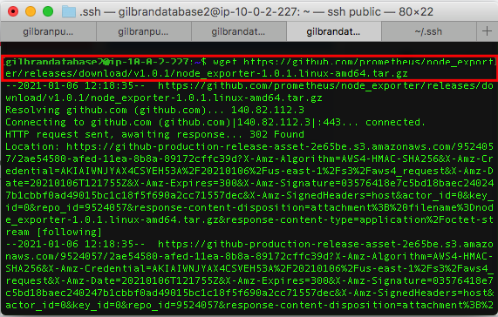
SETUP MONITORING SERVER
Install Node Exporter

Slide 6
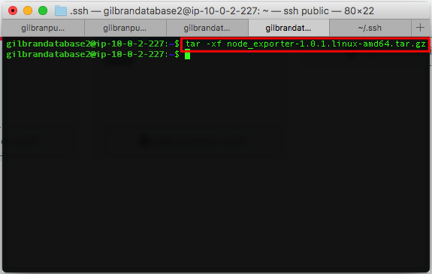
SETUP MONITORING SERVER
Install Node Exporter

Slide 7
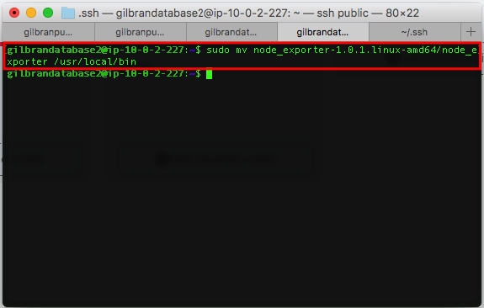
SETUP MONITORING SERVER
Install Node Exporter

Slide 8
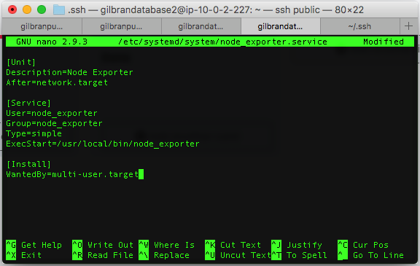
SETUP MONITORING SERVER
Install Node Exporter

Slide 9
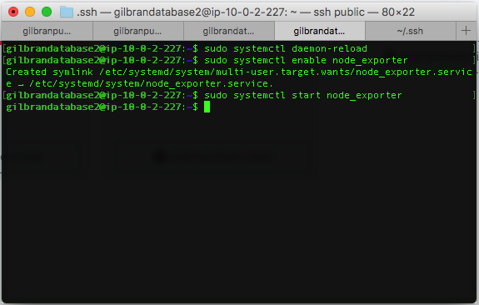
SETUP MONITORING SERVER
Install Node Exporter

Slide 10
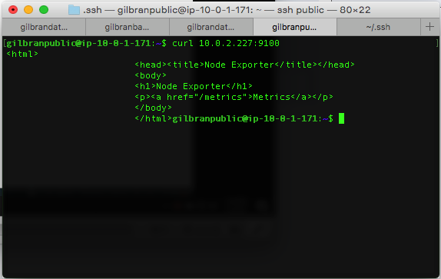
SETUP MONITORING SERVER
Install Node Exporter

Slide 11
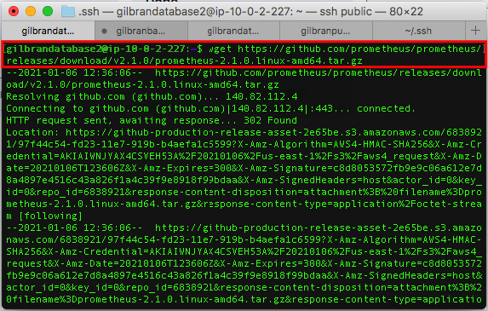
SETUP MONITORING SERVER
Install Prometheus
Prometheus hanya diinstall di server master.

Slide 12
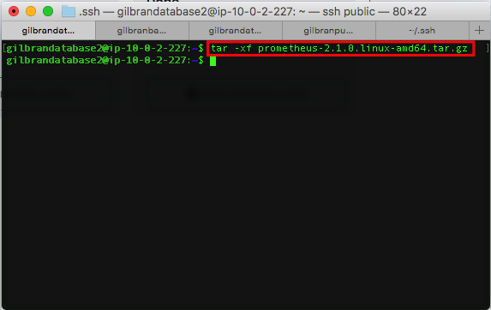
SETUP MONITORING SERVER
Install Prometheus

Slide 13
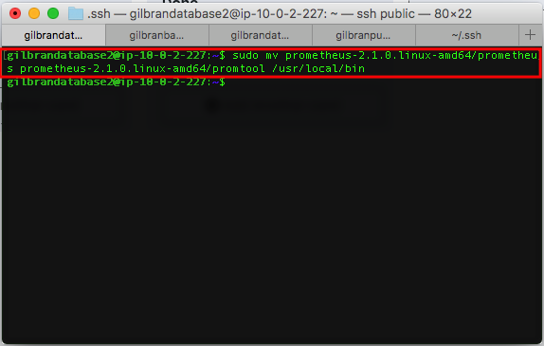
SETUP MONITORING SERVER
Install Prometheus

Slide 14
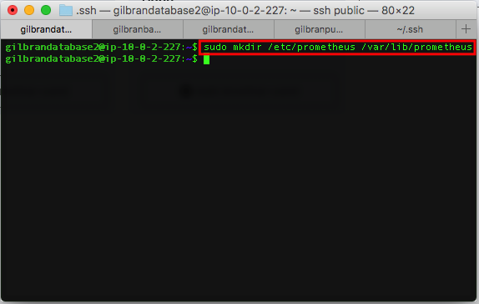
SETUP MONITORING SERVER
Install Prometheus

Slide 15
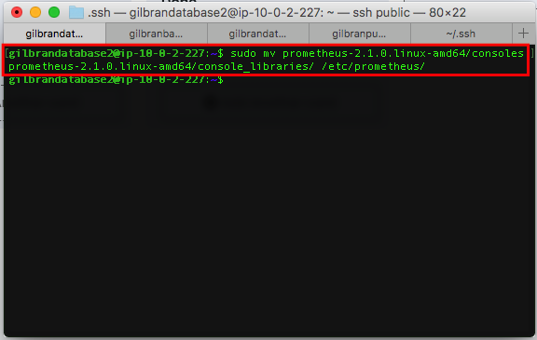
SETUP MONITORING SERVER
Install Prometheus

Slide 16
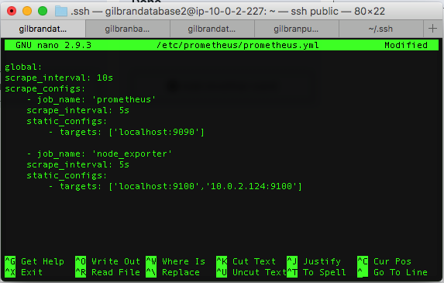
SETUP MONITORING SERVER
Install Prometheus

Slide 17
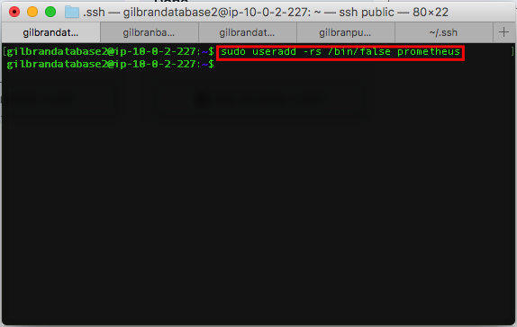
SETUP MONITORING SERVER
Install Prometheus

Slide 18
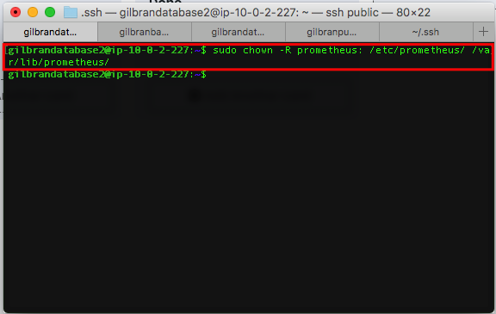
SETUP MONITORING SERVER
Install Prometheus

Slide 19
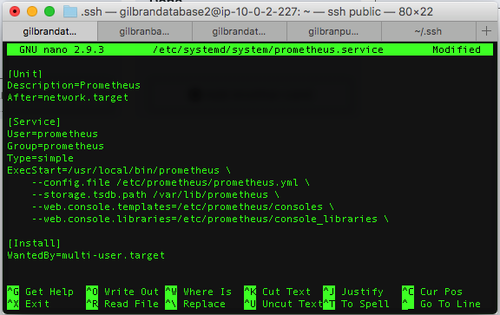
SETUP MONITORING SERVER
Install Prometheus

Slide 20
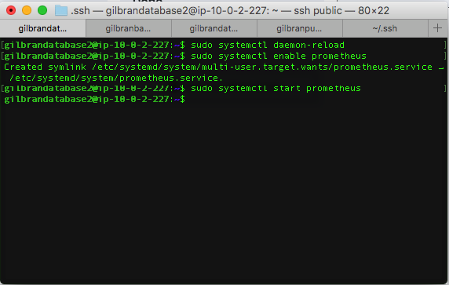
SETUP MONITORING SERVER
Install Prometheus

Slide 21
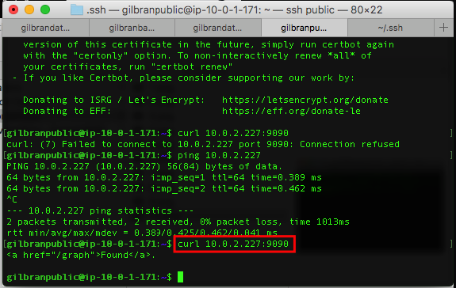
SETUP MONITORING SERVER
Install Prometheus

Slide 22
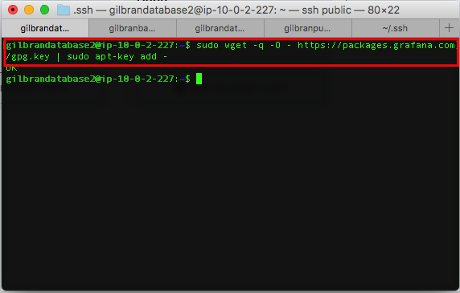
SETUP MONITORING SERVER
Install Grafana.
Grafana hanya diinstall di server master.

Slide 23
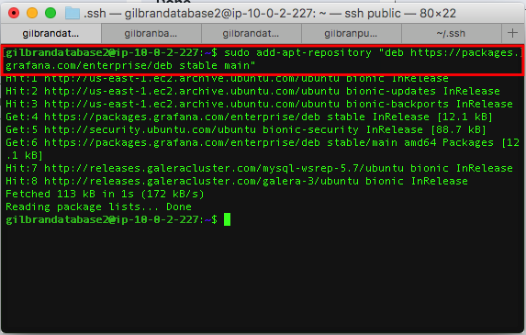
SETUP MONITORING SERVER
Install Grafana.

Slide 24
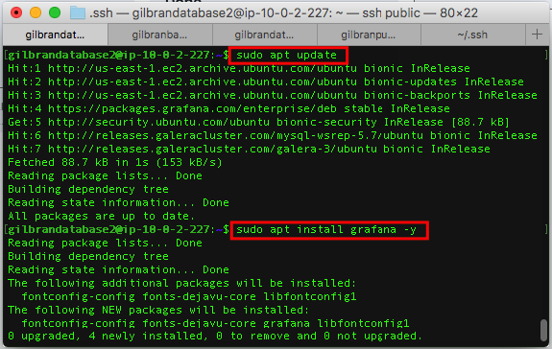
SETUP MONITORING SERVER
Install Grafana.

Slide 25
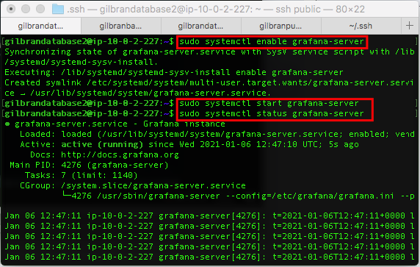
SETUP MONITORING SERVER
Install Grafana.

Slide 26
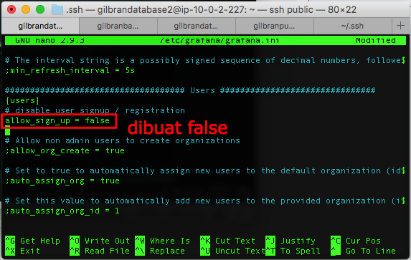
SETUP MONITORING SERVER
Install Grafana.

Slide 27
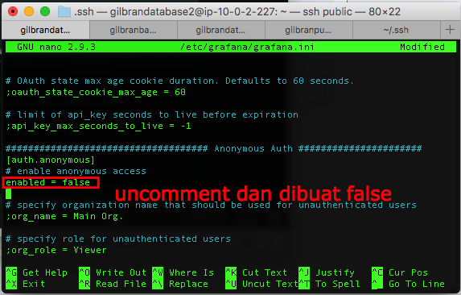
SETUP MONITORING SERVER
Install Grafana.

Slide 28
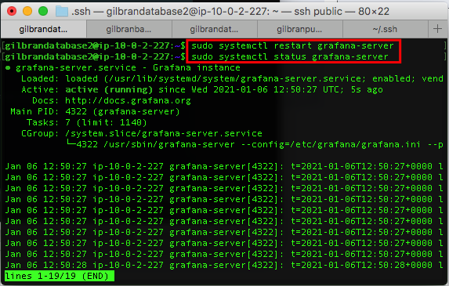
SETUP MONITORING SERVER
Install Grafana.

Slide 29
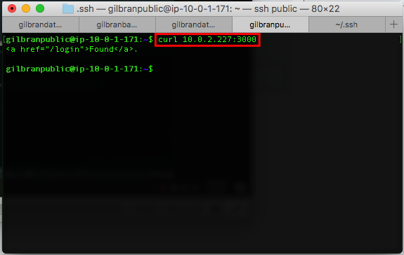
SETUP MONITORING SERVER
Install Grafana.

Slide 30
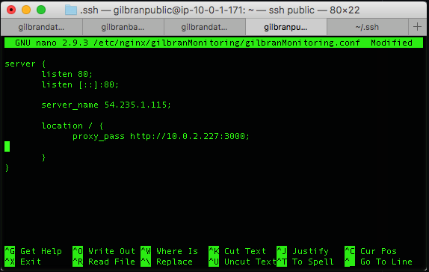
SETUP MONITORING SERVER
Reverse Proxy, Domain, dan SSL

Slide 31
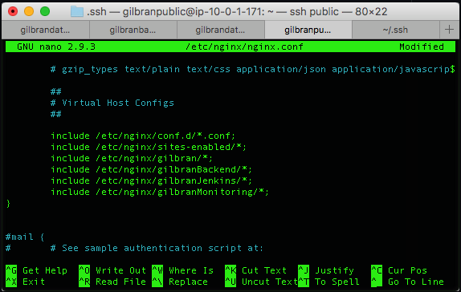
SETUP MONITORING SERVER
Reverse Proxy, Domain, dan SSL

Slide 32
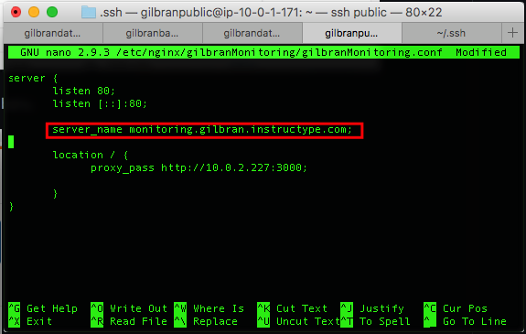
SETUP MONITORING SERVER
Reverse Proxy, Domain, dan SSL

Slide 33
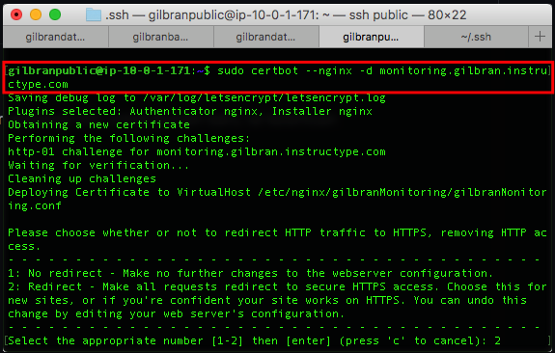
SETUP MONITORING SERVER
Reverse Proxy, Domain, dan SSL

Slide 34
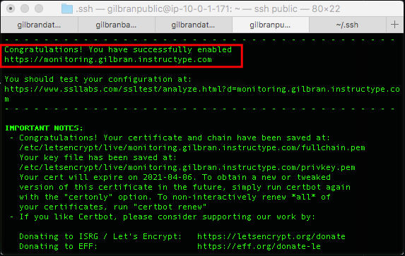
SETUP MONITORING SERVER
Reverse Proxy, Domain, dan SSL

Slide 35
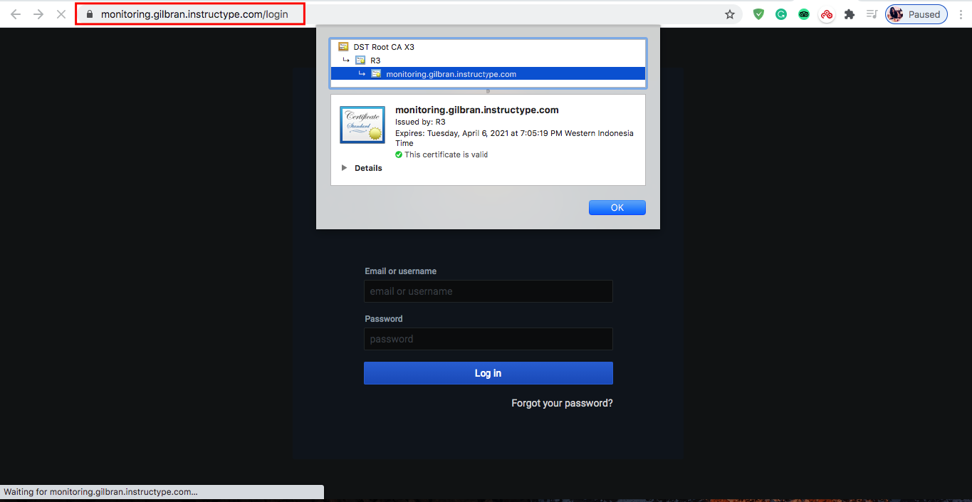
SETUP MONITORING SERVER
Reverse Proxy, Domain, dan SSL

Slide 36
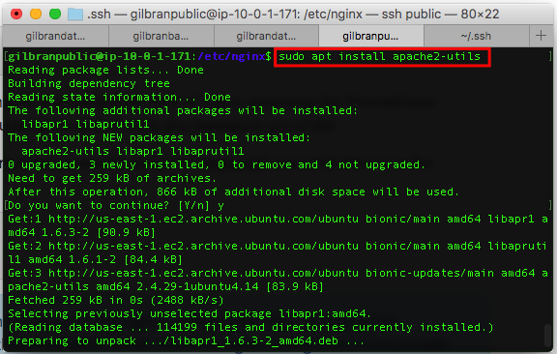
SETUP MONITORING SERVER
Authentication on Prometheus

Slide 37
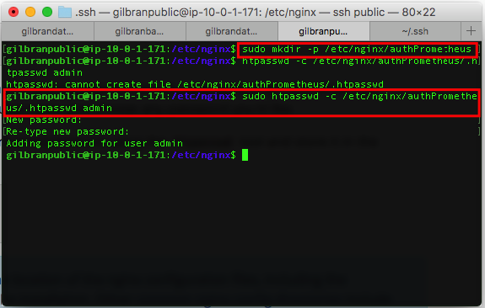
SETUP MONITORING SERVER
Authentication on Prometheus

Slide 38
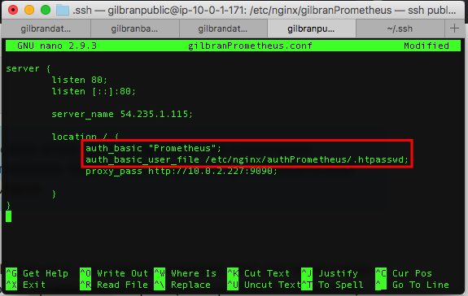
SETUP MONITORING SERVER
Authentication on Prometheus

Slide 39
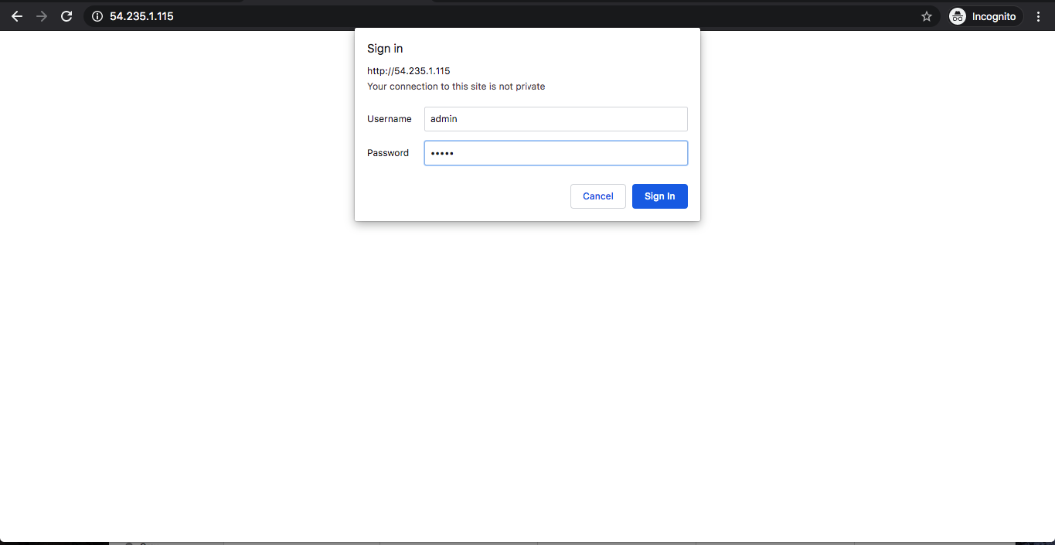
SETUP MONITORING SERVER
Authentication on Prometheus

Slide 40
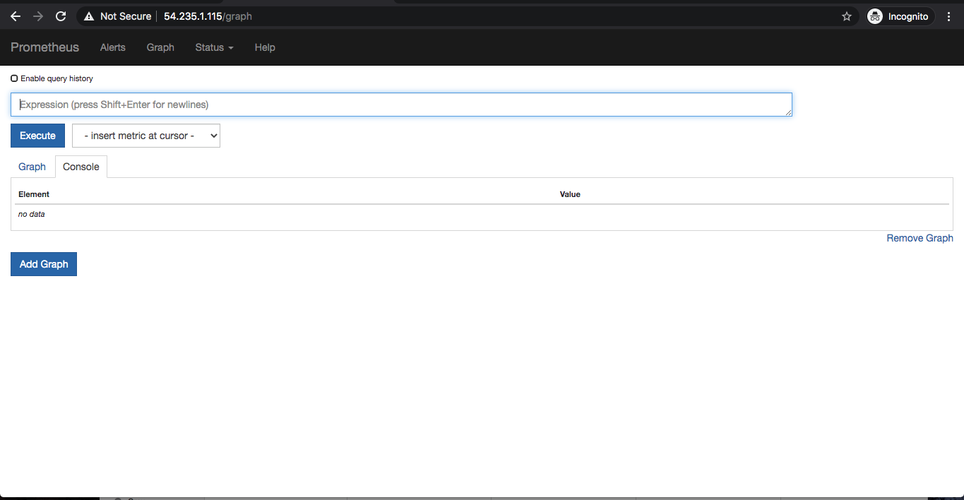
SETUP MONITORING SERVER
Authentication on Prometheus

Slide 41
CONNECT MULTIPLE SERVER TO PROMETHEUS
02

Slide 42
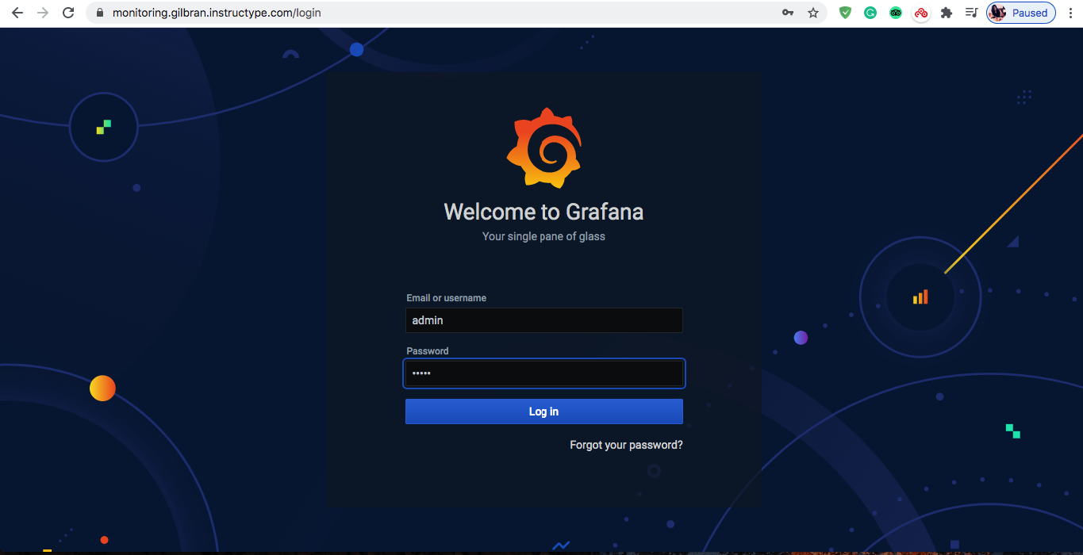
CONNECT MULTIPLE SERVER TO PROMETHEUS
Setup Grafana

Slide 43
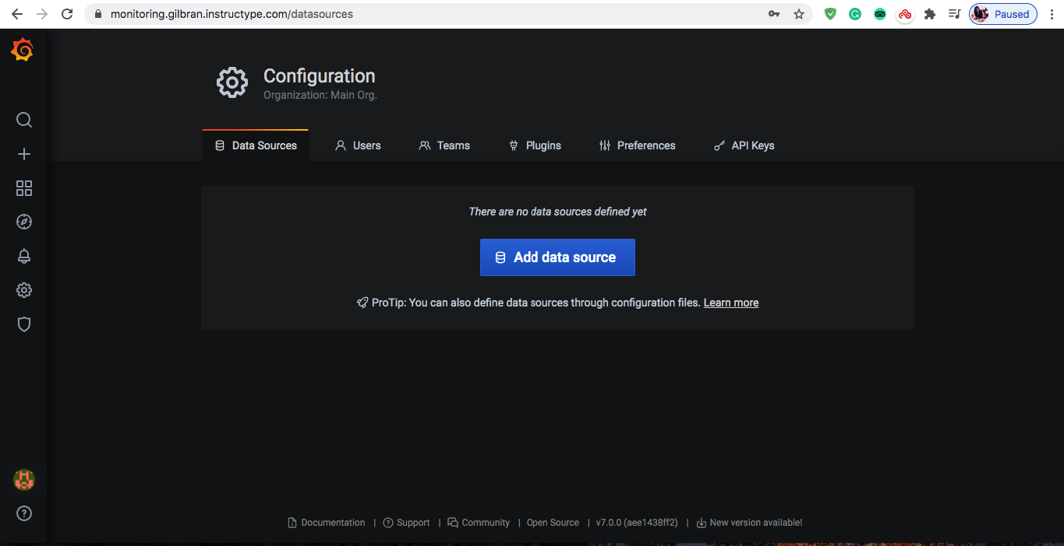
CONNECT MULTIPLE SERVER TO PROMETHEUS
Setup Grafana

Slide 44
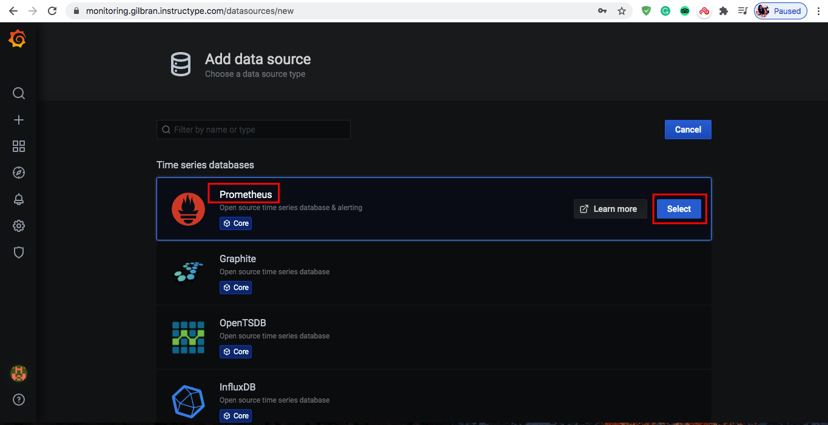
CONNECT MULTIPLE SERVER TO PROMETHEUS
Setup Grafana

Slide 45
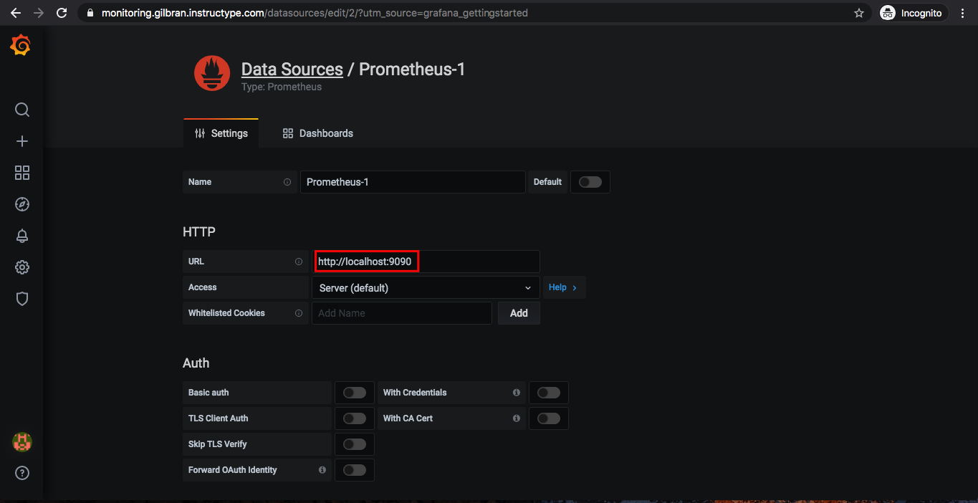
CONNECT MULTIPLE SERVER TO PROMETHEUS
Setup Grafana

Slide 46
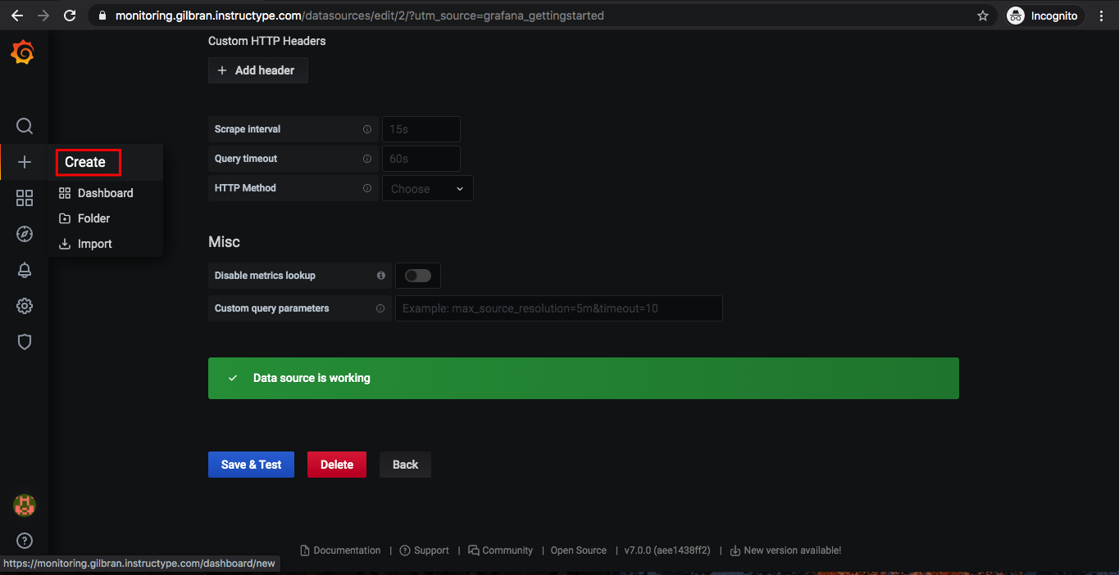
CONNECT MULTIPLE SERVER TO PROMETHEUS
Setup Grafana

Slide 47
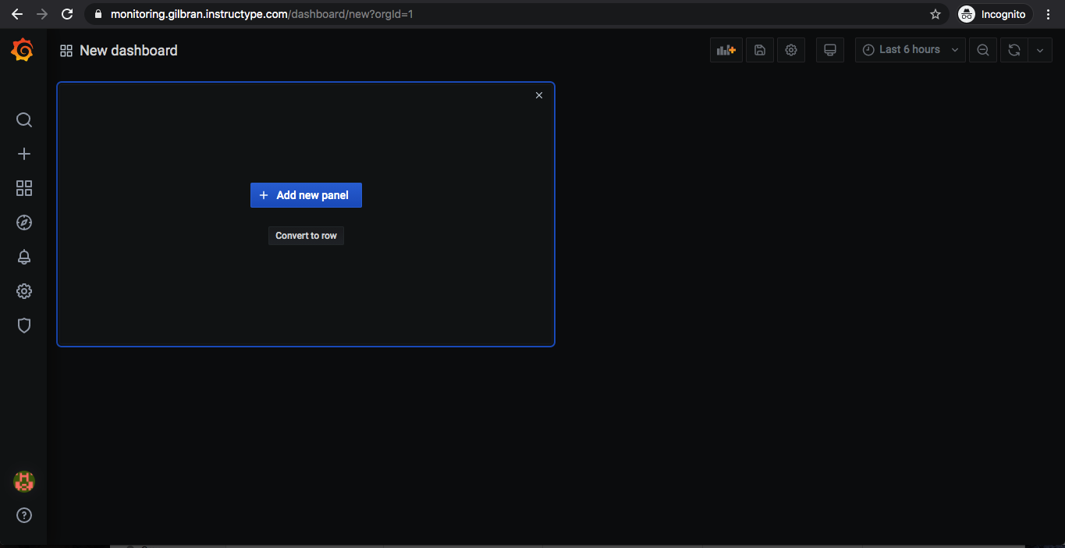
CONNECT MULTIPLE SERVER TO PROMETHEUS
Setup Grafana

Slide 48
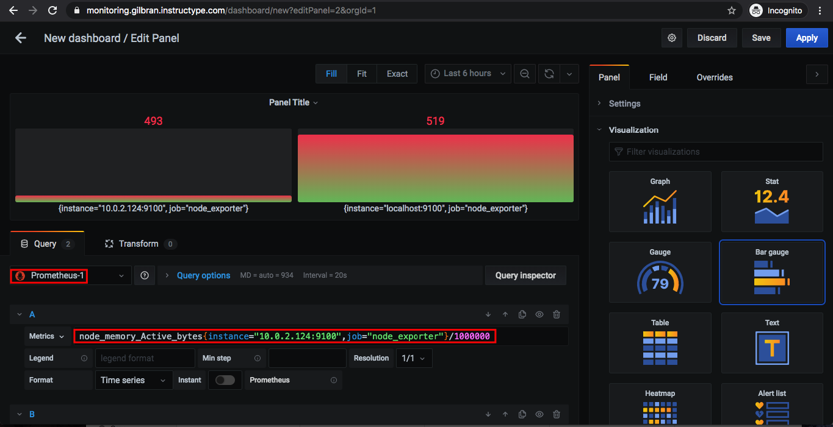
CONNECT MULTIPLE SERVER TO PROMETHEUS
Setup Grafana

Slide 49
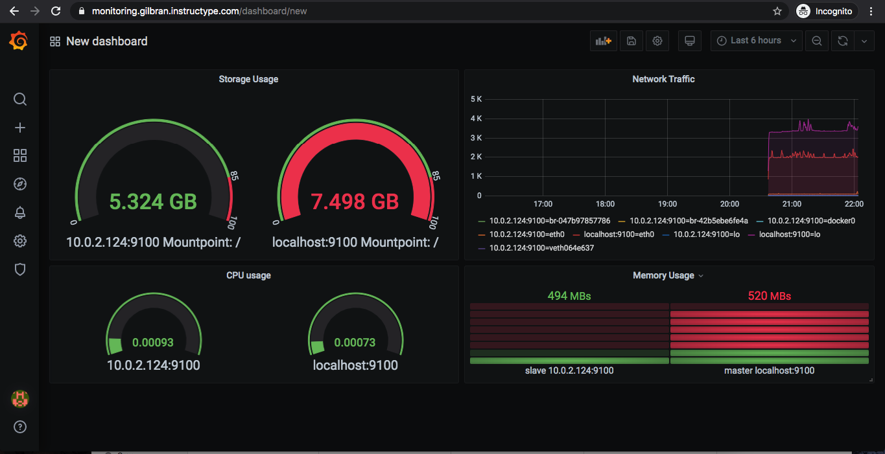
CONNECT MULTIPLE SERVER TO PROMETHEUS
Setup Grafana

Slide 50
DEPLOY PHP APPLICATION IN CPANEL
03

Slide 51
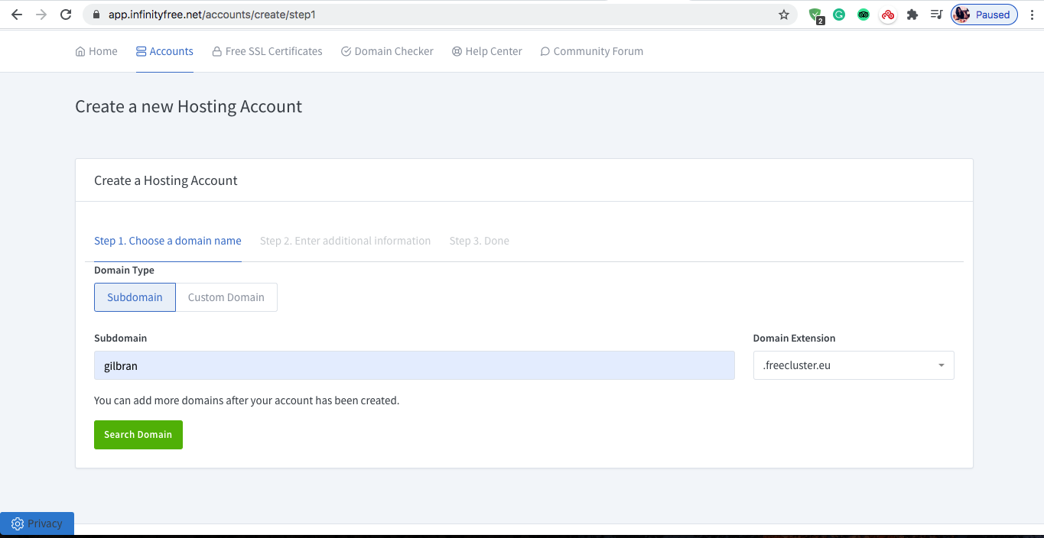
DEPLOY PHP APPLICATION IN CPANEL

Slide 52
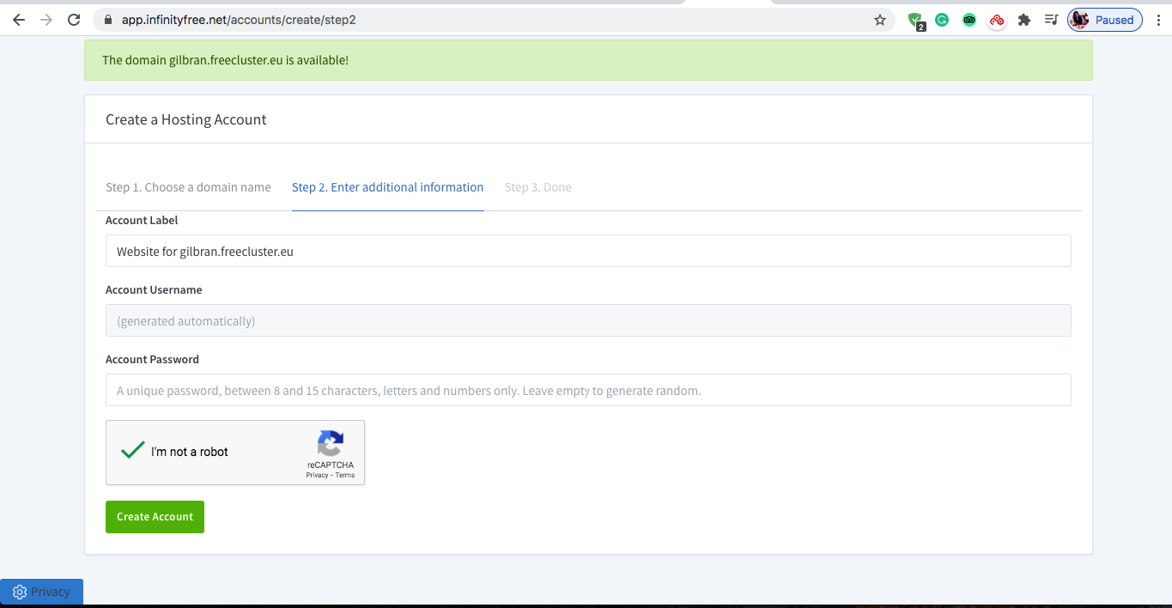
DEPLOY PHP APPLICATION IN CPANEL

Slide 53
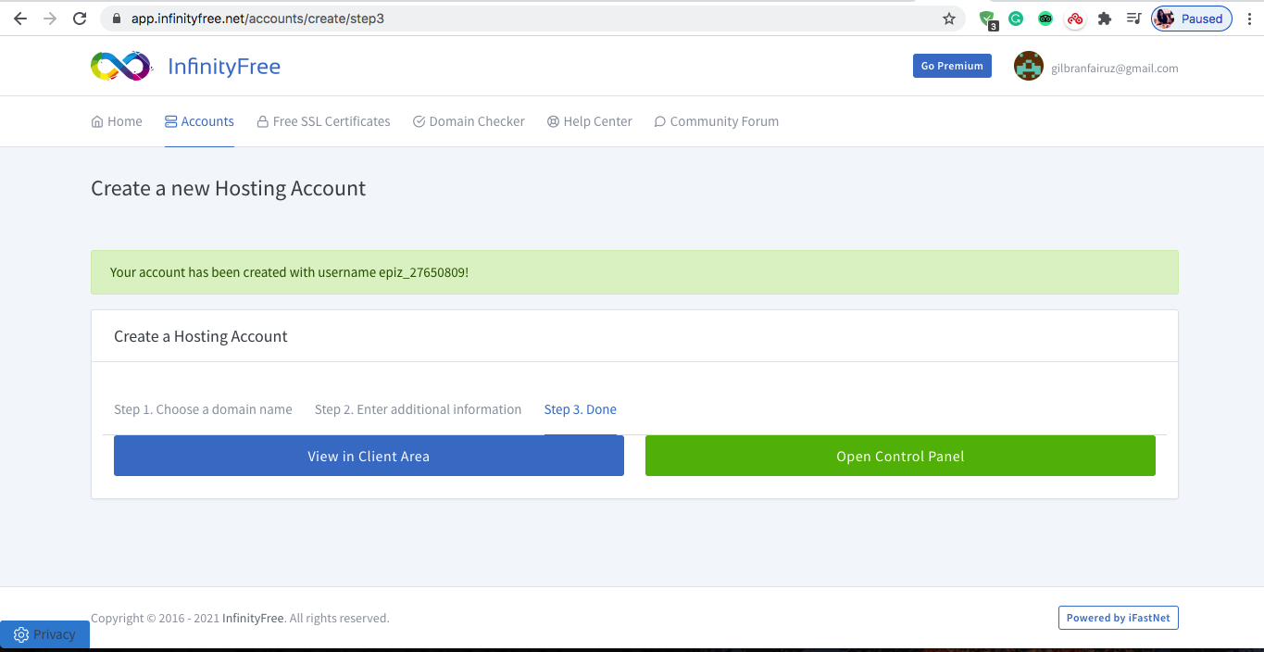
DEPLOY PHP APPLICATION IN CPANEL

Slide 54
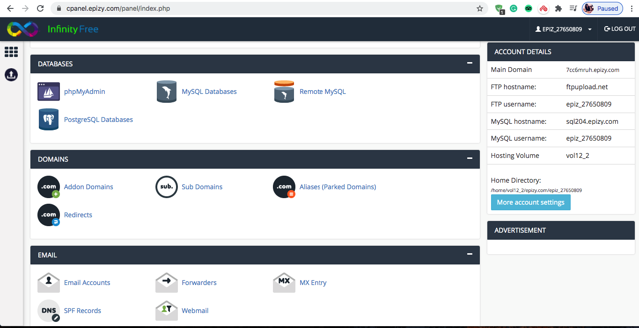
DEPLOY PHP APPLICATION IN CPANEL

Slide 55
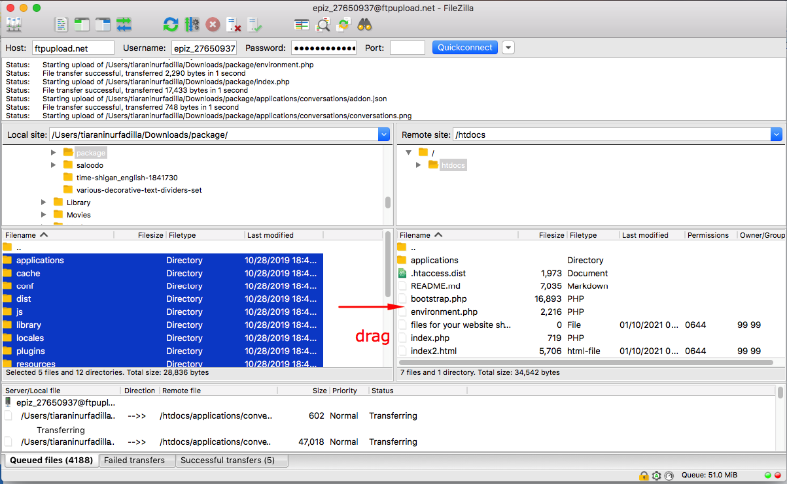
DEPLOY PHP APPLICATION IN CPANEL

Slide 56

DEPLOY PHP APPLICATION IN CPANEL

Slide 57

DEPLOY PHP APPLICATION IN CPANEL

Slide 58

DEPLOY PHP APPLICATION IN CPANEL

Slide 59

DEPLOY PHP APPLICATION IN CPANEL

Slide 60

DEPLOY PHP APPLICATION IN CPANEL

Slide 61

DEPLOY PHP APPLICATION IN CPANEL

Slide 62

DEPLOY PHP APPLICATION IN CPANEL

Slide 63

DEPLOY PHP APPLICATION IN CPANEL

Slide 64

DEPLOY PHP APPLICATION IN CPANEL

Slide 65

DEPLOY PHP APPLICATION IN CPANEL

Slide 66
SETUP SERVER WITH ANSIBLE
04

Slide 67

SETUP SERVER WITH ANSIBLE
Install Ansible

Slide 68

SETUP SERVER WITH ANSIBLE
Install Ansible

Slide 69

SETUP SERVER WITH ANSIBLE
Install Ansible

Slide 70

SETUP SERVER WITH ANSIBLE
Install Ansible

Slide 71

SETUP SERVER WITH ANSIBLE
Install Nginx

Slide 72

SETUP SERVER WITH ANSIBLE
Install nginx

Slide 73

SETUP SERVER WITH ANSIBLE
Clone Repo

Slide 74

SETUP SERVER WITH ANSIBLE
Clone Repo

Slide 75

SETUP SERVER WITH ANSIBLE
Install docker

Slide 76

SETUP SERVER WITH ANSIBLE
Install docker

Slide 77

SETUP SERVER WITH ANSIBLE
Install mysql server

Slide 78

SETUP SERVER WITH ANSIBLE
Install mysql server

Slide 79

SETUP SERVER WITH ANSIBLE
Install mysql client

Slide 80

SETUP SERVER WITH ANSIBLE
Install mysql client

Slide 81

SETUP SERVER WITH ANSIBLE
Run docker container

Slide 82

SETUP SERVER WITH ANSIBLE
Run docker container

Slide 83

SETUP SERVER WITH ANSIBLE
Hasil Setup

Slide 84

SETUP SERVER WITH ANSIBLE
Hasil Setup

Slide 85

SETUP SERVER WITH ANSIBLE
Hasil Setup

Slide 86

SETUP SERVER WITH ANSIBLE
Hasil Setup

Slide 87

SETUP SERVER WITH ANSIBLE
Hasil Setup

Slide 88

SETUP SERVER WITH ANSIBLE
Hasil Setup

Slide 89
Terima Kasih

